Slide 1
DCAF Training
Benjamin Celis

Slide 2
Agenda
Introduction to DCAF
RT Key Concepts Review
Using LabVIEW Objects
DCAF Components
Designing an application with DCAF
Selecting the Right Modules
Reusing Modules
Static Template
Dynamic Template
System Link
dfsfasdsadsad

Slide 3
Introduction To DCAF

Slide 4
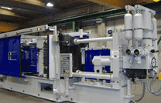
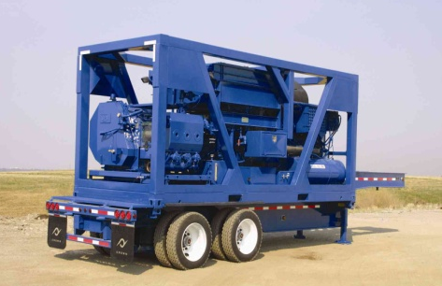
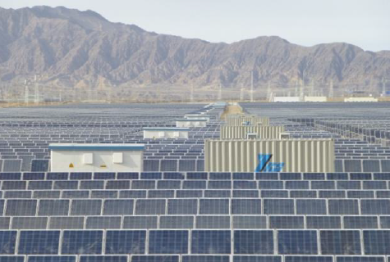

Programming Embedded Control Applications is Hard
RT, FPGA, and user interface programming
Distributed I/O and execution
High cost of failure
Execution guarantees
Understand failure root cause
High availability
System commissioning
Software updates and deployments
Multi-developer teams
Error Handling
Plus the crazy things it actually has to do!
Manufacturing Machines
Heavy Machinery and Equipment
Power Conversion Equipment
Medical Devices
Notes:
RT, FPGA, and UI programming can vary widely in style and knowledge requirements. Being proficient in all three takes both training and experience.
Distributed I/O and execution means a variety of communication protocols to learn. CAN, EtherCAT, UDP, TCP, AMQP, and possibly even the upcoming IIoT protocols may all be involved.
Execution guarantees require knowledge of deterministic programming techniques. Understanding why something failed requires built-in diagnostics and good error handling.
High availability means programs need to be able to run for months or longer without stopping. They also need to be able to recover from a failure automatically.
No two machines are exactly the same. Tuning, features, parameters often need to be tweaked during setup. This requires extensive and powerful parameterization, which ideally is built into the code before it is needed.
These machines are typically built to last. Development teams need a strategy for how to get updates to the code. How do bug fixes or new features get deployed reliably?
These systems are often complex enough and with a tight enough timeline to require multiple software developers. Multi-developer teams don’t work efficiently overnight, and require training and process investments to really flourish.
To top it all off, the functionality for these machines in terms of their primary tasks are complex and getting even more so. It also needs to do those tasks better than the competition.

Slide 5

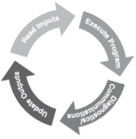






Distributed Control and Automation Framework (DCAF) Overview
An open-source LabVIEW framework for creating configurable, latest value, data engines that can acquire data from multiple input sources, process that data, and then route it back to outputs or to data services.
Create higher quality control applications, in less time.
Scalable and extensible plugin
architecture
Develop with plugin templates
Reuse existing plugins
Define and configure plugin
parameters
Single point I/O, processing, and
data services
Rules for correct-by-construction
software
Configure timing and error handling
Optimized for real-time execution
Notes:
The Tag Bus Data Framework or TBDF is an open-source LabVIEW framework for creating configurable, latest value, data engines that can acquire data from multiple input sources, process that data, and then route it back to outputs or to data services. It provides a scalable and extensible plugin architecture. It supports users in the development of new plugins with a variety of templates… …and the framework was designed to allow plugins to be reused easily across projects. Reuse is easy because each plugin can define configuration parameters which can be specified using a configuration editor. This also allows plugin behavior to change across multiple deployments of the same application. While applicable to a wide variety of use-cases, the framework was primarily built for applications using a lot of single point I/O: things like control data or industrial communication protocols. The plugin architecture helps facilitate multideveloper teams, and the framework handles the intricacies of execution timing and error handling for its users. Finally, while the framework can run on RT, Windows, and Interact with FPGAs, it was built primarily for applications executing on a real-time OS.

Slide 6
Who should use the framework?
New developers in LabVIEW:
Allows them to work on what the application has to do, rather than how they have to do it.
Abstracts Real Time concepts for the user
Provides a configurable I/O Abstraction layer
Forces good programing practices
Advanced developers:
Efficient data mapping engine
Extensible configuration interface
Excellent code reuse between projects
Know LabVIEW but doesn’t want to write too much architecture
Open source and distributed in components that are useful individually

Slide 7
DCAF Components
Configuration
Runtime
Configuration Editor
Engine
Modules

Slide 8
RT Key Concepts

Slide 9
RT Key Concepts
Real Time Jitter
Timing
Parralelism

Slide 10
Agenda
Introduction:
Object user levels
Libraries and scope
Clusters
Methods
Why to use classes?
Dynamic dispatch
Reuse
Using objects
Next steps
Notes:
The idea behind this presentation is allow new LabVIEW users to understand how LabVIEW objects work, based on the concepts they are already familiar. Once they realize that Objects are nice clusters inside of a library we will talk about the advantages of using them
There are many examples to explain Object Oriented. In this presentation we are going to use the Shape example having a square and a circle.
For the Advance demo we are using CEF. This is not cover in the application. And is just shown in how to override a method. The same demo can be done just with the classes, In the slides I am using the screenshots from the CEF. But can be replaced with the Shape. I attached the slides for shape at the end of the slides.

Slide 11
Object User Levels
LabVIEW Object Designer
Designs the top level application
Defines the abstract classes
Decides inheritance paths
LabVIEW Object User
Uses object oriented based architectures like Actor Framework or Configurator Editor Framework (CEF)
Creates child classes of abstract objects
Notes:
In general when working with LabVIEW object oriented we work with them at 2 different levels:
Object Oriented Designer
Object user.
The purpose of this presentation is to help LabVIEW objects users to get familiar with objects and rip the benefits of working with them . In this slide is intentional the use of terms they will hear when talking about when talking about objects but they might be not familiar. During the presentation they will realize that in many cases they just know it with a different name.

Slide 12
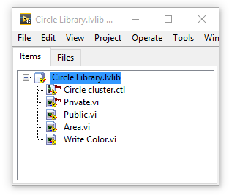
Libraries
A collection of related VIs, type definitions, shared variables, palette menu files, and other files
Organize related files into a shared hierarchy
Limit public access to certain files
Avoid potential VI name duplications
2 way link
Notes:
Public—Any VI can call the member VI as a sub VI.
Community—Only VIs within the same library, friends of the library, or VIs within a friend library can call the member VI. Community member VIs display a dark blue key glyph in the Project Explorer window. Refer to the Object-Oriented Design and Programming in LabVIEW course for more information about this scope.
Private—Only VIs within the same library can call the member VI. Private member VIs display a red key glyph in the Project Explorer window.
2 way link, the library knows what files belong to the library and the files know to which library they belong. Only LabVIEW files (controls, Vis and libraries) can be inside of a library
Name Space: A VI is loaded into LabVIEW memory using the Library name as part of its name. For example VI save in library File, would be read as File:Save. This allows me to also have a si called Save in a Configuration library because it will appear as Configuration:Save.
You still cant have both files in the same folder. You should always create a folder for each class.

Slide 13
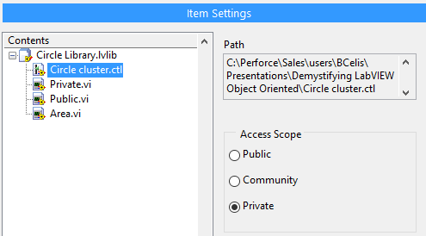
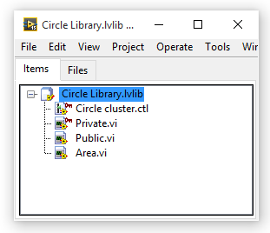
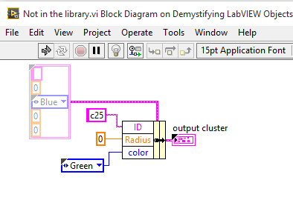
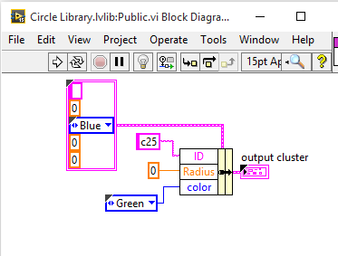
Access Scope
Notes:
Public—Any VI can call the member VI as a sub VI.
Community—Only VIs within the same library, friends of the library, or VIs within a friend library can call the member VI. Community member VIs display a dark blue key glyph in the Project Explorer window. Refer to the Object-Oriented Design and Programming in LabVIEW course for more information about this scope.
Private—Only VIs within the same library can call the member VI. Private member VIs display a red key glyph in the Project Explorer window.
2 way link, the library knows what files belong to the library and the files know to which library they belong
Talk about the benefit of Data Encapsulation.

Slide 14
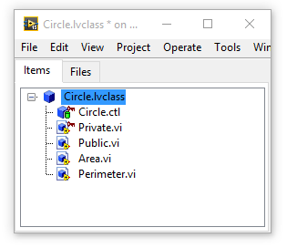
LV Class
A collection of related VIs, type definitions, shared variables, palette menu files, and other files
Organize related files into a shared hierarchy
Avoid potential VI name duplications
Limit public access to certain files
2 way link
Inheritance and dynamic dispatch
Property nodes
Notes:
The same as with the Class Private Data slide. It is almost the same expect for the Dynamic Dispatch. WE are going to talk about that in the second part of the presentation.
Property nodes are methods that can be accessed using the

Slide 15
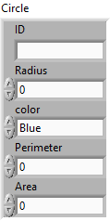
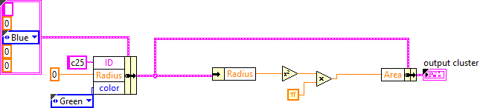
Cluster
It’s a data structure
Clusters group data elements of mixed types
Bundle and unbundle
Pink, brown or beer yellow
Notes:
Clusters are basic data structures in LabVIEW
They allow us to bundle multiple wires and values in a single LabVIEW wire simplifying our block diagram and organizing data in a logical way.
Whenever we create a cluster is a good practice to make it a Type def.
Most clusters on the block diagram have a pink wire and data type terminal.
Clusters of numeric values, sometimes referred to as points, have a brown wire and data type terminal.
You can wire brown numeric clusters to Numeric functions to perform the same operation simultaneously on all elements of the cluster.
Error wire is a cluster.

Slide 16
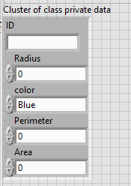
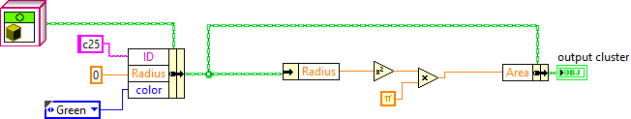
Class Private Data
It’s a data structure
Clusters group data elements of mixed types
Bundle and unbundle
You can choose the color you want
It defines the class properties
It is private
Notes:
The private Data of a class is just a cluster, that behaves like a cluster but is private to the class library. This means it can only be bundle and unbundled by Vis that belong to the class. That will be explain with the libraries.
The Private class data define the properties of a Class.

Slide 17
Methods: Color and Area

Slide 18
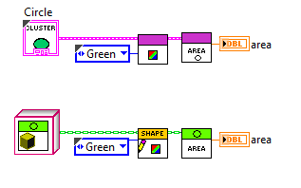
Methods: Color and Area
Notes:
Again the comparison between our class implementation is identical between the cluster and the Object. As long as I only have Circles. But the Square makes everything more complicated. How can I calculate the area of the Square and the circle.
The sub VIs that belong to a class are named Methods.
We are using Vis (Methods) to change the values in the cluster (properties)

Slide 19
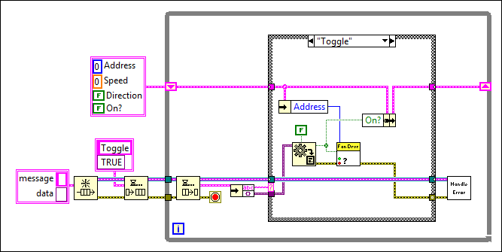
Cluster and Node...
Notes:
This is a data handler. This app is not using objects it just has a cluster and some sub VI. This is to compare the code between the 2 applications in a more complex application.

Slide 20
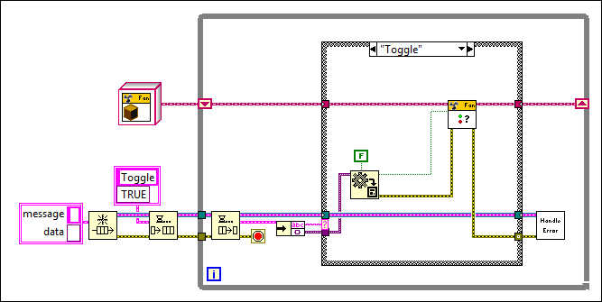
… become Class and Method
Notes:
This screenshot is from Actor Framework. It wont be covered in this presentation but its good to know what it is.
Still the idea here is that a code with or without classes looks similar. Except it looks cleaner with classes and we can expand it latter.

Slide 21
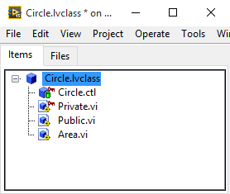
Cluster vs Class
Library
Cluster
VIs
LV Class
Private Data
Methods
=
=
=
Notes:
Class as a Data Type
A class is a collection of data bundled together with the set of methods (or functions) which interact with that data.
An class treats these two components as an inseparable whole (a concept known as encapsulation). When you pass an class around, you are passing both data and a way to use the data.

Slide 22
Why to Use Classes?

Slide 23
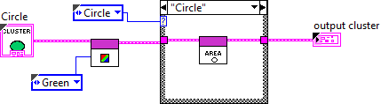
Possible Cluster implementation
What if properties are different? Ex: radio vs side
Should I modify the cluster or make 2 different clusters?
How do I know if the shape is a circle or a square. Add a enum?
Arrays?
Scaling issues
Repeated code
Notes:
Adding a new shape brings new problems:
Should I use a second cluster? If we go with 2 clusters that means that I need 2 different Vis for Set color as they have a different cluster for input.
With the internal data Either make a generic cluster hard to use. Or have to use different arrays one for Squares.
You can NOT make arrays of different clusters.
If I add triangle. I have to modify the top level VI affecting the case
Note: Point that is always important to make Enums Type definitions

Slide 24
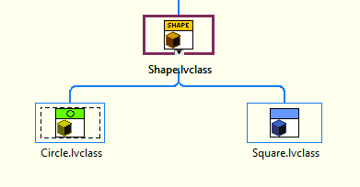
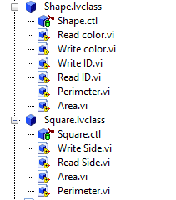
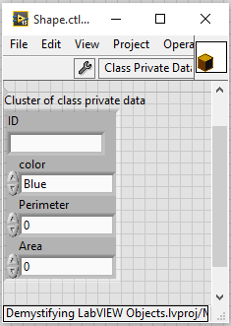
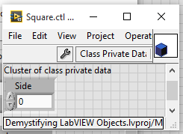
Inheritance
Common information Is stored in the parent
Childs only override what they need
Can build arrays
Can extend functionality without affecting the parent
Allows code reuse
Notes:
We can create a top level class called shape.
This class contains all the properties common to all classes. As well as its methods. You can point to Read ID and Write ID
The child class just need to implements the specifics

Slide 25
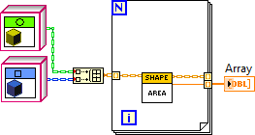
Adding the Square with Objects
Dynamic dispatch
Code is easier to read
Code is easier to maintain
Notes:
Note how the wire changes to orange at the bundle array. That is because it is changing to the parent class.
Dynamic dispatch selects which area I am calling. I don’t need additional identifiers, or case structures. Also I don’t need to modify the code inside the for loop to add additional shapes.

Slide 26
Disadvantages
More VIs
But Smaller and more modular
Have to be careful to include children classes when deploying code
But you have dynamic dispatch
Dynamic dispatch overhead
Cleaner code
Easier to debug
Notes:
In general most of the programs using LVOOP will have more VIs
Not everything is nice with objects. As with any architecture decision using objects has some drawbacks.
There are more Vis but Vis are smaller and more modular.
Even if you only have 1 class, the overhead of calling the methods is a larger than just using a cluster, as it needs to make identify the right class, even if there is one. This overhead is small considering the advantages OOP provides, still you should be careful not to overuse objects. If we have 2 Methods Add, and substract, and we have 100 elements, its better to have a dynamic dispatch method that works with an array inside, than calling 100 times method that only does one operation.

Slide 27
Working with LabVIEW OPP Architectures
DEMO
Notes:
Now that we know the basics, and understand that an object is cluster with a library and Dynamic dispatch allows us to call methods specific to the child we can talk about working with an architecture built with objects
As we mentioned before the idea of this presentation is helping the developers that have to face
Script is at the end of the slides. The 2 options for the demo is using the CEF example (Recommended) or just adding the triangle. The script is as slides, so if you are not comfortable showing it in LabVIEW you can present with the slides. Still It is simple enough that I Recommend a live demo.
The Architect already defined the classes
The Top Level VIs exist.
We need to extend and work with the Architecture provided.
The basic procedure is Create a new class
Inherit from parent
Customize the class: add properties and methods
Add class to main application

Slide 28
Demo Summary
Create new child from the parent class
Each class should be saved in its own folder
Override methods
Add your new class to the program
Notes:
To create a new child, create a new class file and change inheritance to point to the parent class.
Name space with the libraries, work inside of LabVIEW but not at the OS level, you cant have 2 Vis from different classes with the same name
You must override all the methods marked as Required, and the ones that have different behavior on the specific class.
How you add the class to the program will vary depending on the main VI architecture. In some cases you just need to add the children on a folder, and the main program will load into memory any plug in in there. In some cases you need to add the class constant in the initialization VI of the application, or in some cases you need to modify the part of the code that will call the class. In the CEF example we need to modify the Group>>Edit Options Vis to include he new channel.

Slide 29
Using Classes

Slide 30
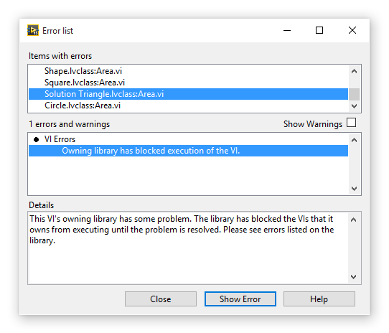
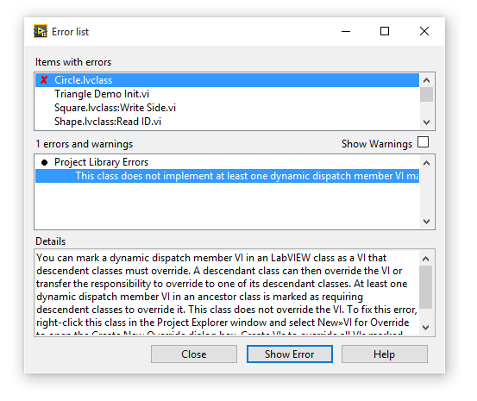
Errors in Classes
Notes:
One of the Most common problems with classes is that it has a broken run arrow, even if everything is fine in the VI. This overwhelms new class users and confuses them.
This happens because the parent class knows one method of one child is broken and is preventing you run by dynamic dispatch that vi.
To fix it search the vis with the X which are the ones with the actual error.

Slide 31
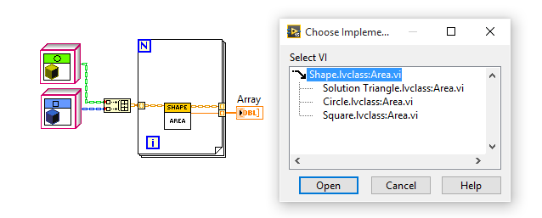
Selecting the Specific Implementation
Notes:
In this example when I double Click on the area VI it wont open a block diagram directly
It will give me a list of possible implementations. In here I can select which of this implementations I want to see.
If a method is in gray that means that child class has no implementation of it and is using the parent method.

Slide 32

More Specific and Less Specific
Up casting allows the class to get to a parent class, with this you can get access to its methods and property nodes
If a property or method are specific to a child you need to down convert to it.
Notes:
You can notice how the wire changes between orange and blue

Slide 33
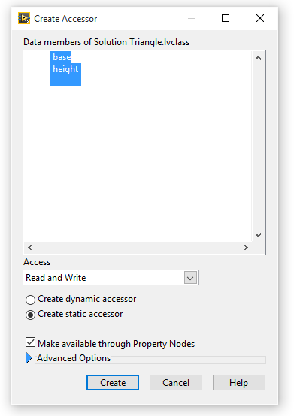

Property Nodes
Property nodes can be created to access the private Data of an object.
Notes:
When we create Accesor, Labview creates methods to acces the properties in the private data. LabVIEW also allows us to represent them as property nodes.

Slide 34
Conclusions
LabVIEW objects could be considered a private clusters inside of a library, with VIs that can be called dynamically using dynamic dispatch
Using objects can make code easier to maintain and extend
Avoiding objects can increase the complexity of your code

Slide 35
Next Steps
Object-Oriented Design and Programming in LabVIEW
NI Reference Designs ni.com/reference designs
LabVIEW Object-Oriented Programming: The Decisions Behind the Design www.ni.com/white-paper/3574/en/
Configuration Editor Framework (CEF) www.ni.com/example/51881/en/
Notes:
Object-Oriented Design and Programming in LabVIEW is a Custed Class that goes into more detail for Using Object Oriented.
Regardless of the implementation example CEF is an example of a Object Oriented Framework you can point people .

Slide 36
Demo: Adding Triangle

Slide 37
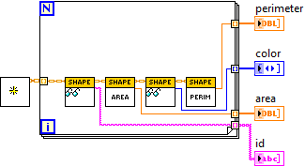
Top Level Application
The top level doesn’t need any changes just the Init to include the triangle
This is an advantage when creating top level VI with Objects
This VI uses dynamic dispatch to get the properties of all the shapes

Slide 38

Creating a new Class
To Create a new class Right click on the My computer
New >> Class
This will generate a new class. Save it to disk to a new folder
Notes:
Its really important to use a new folder every time we generate a class.
Name spacing inside LabVIEW is handle by the library but at windows level, there can’t be 2 files with the same name in the same directory.

Slide 39
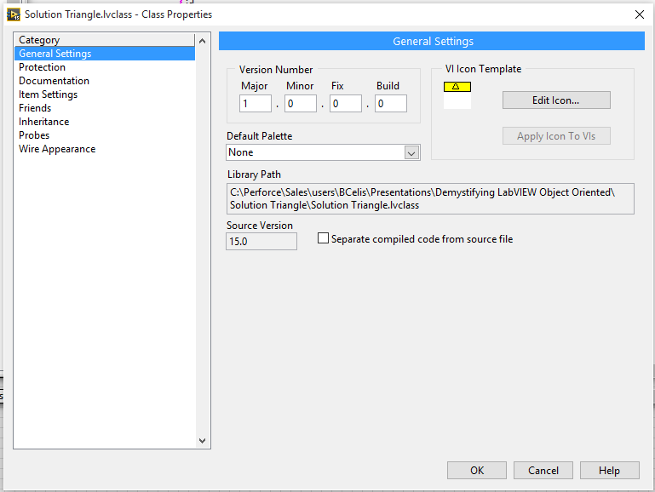
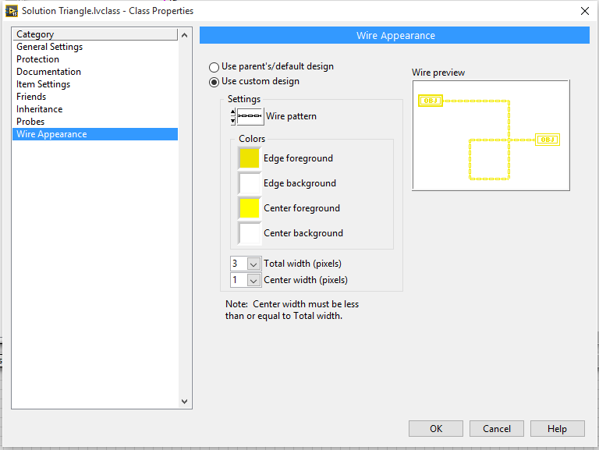
Edit Icon and Wire
Notes:
Updating the wire is optional. It is a good practice to do this with toplevel classes this allows to see upcast and downcast on the wires.

Slide 40
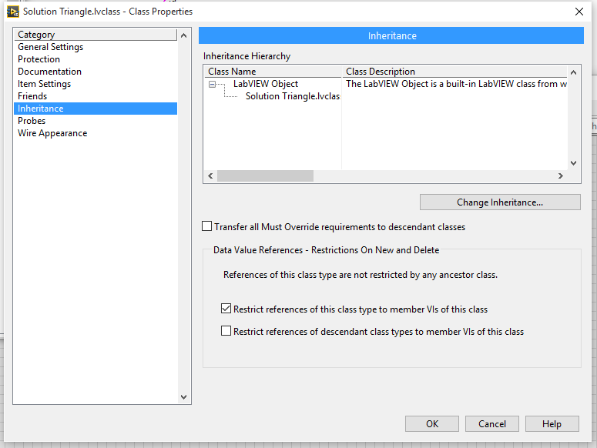
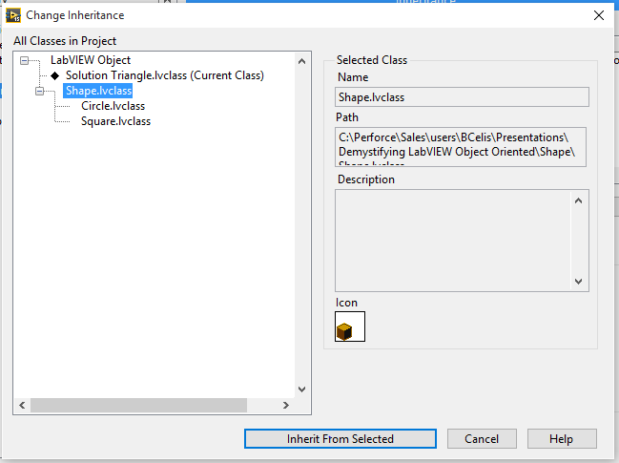
Change Inheritance
Notes:
In properties in the inheritance tab
Select Change Inheritance
The select to inherit from Shape.

Slide 41
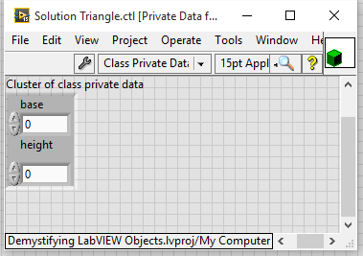
Edit the private Data
For the triangle we need the base and the Height

Slide 42
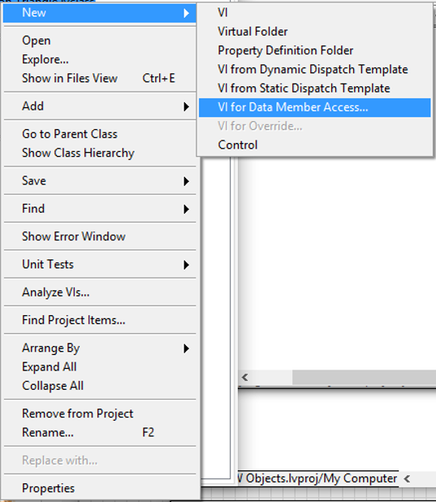
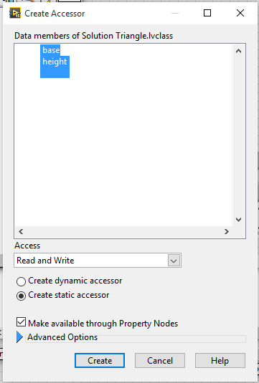
Create Access Methods
Notes:
In here we specify what properties we want. This allows us to auto generate the Vis to read and write to them
Also if we add the make available through property nodes allows us to use property nodes.
After created save the 4 new Vis

Slide 43
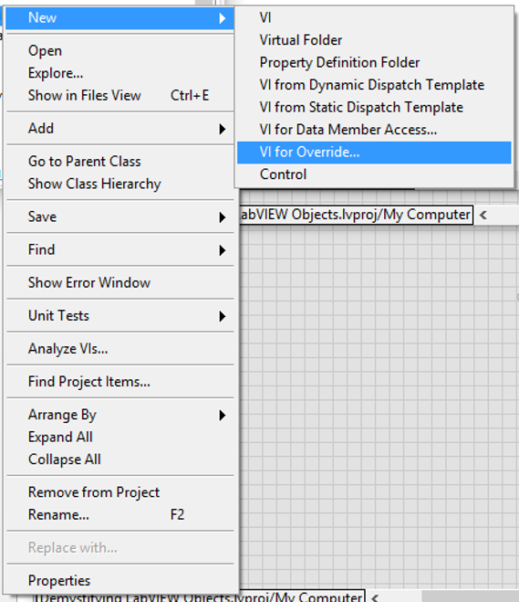
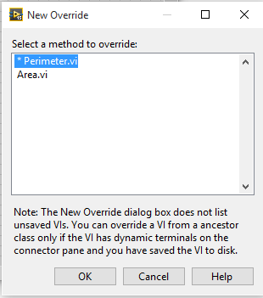
Create Methods for Override
Notes:
The ones with the * are required. The ones without it are not.
In this case we need to override both so select both of them and click OK

Slide 44
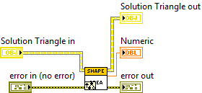

Area VI
Notes:
IN this case we don’t need anything from the parent method so we can delete the VI
The implementation should look like the one on the left
Its important to make sure the object is passed through and also the error.

Slide 45

Perimeter
Notes:
For simple math I am considering an equilateral triangle. So the base is the same length that the other sides.

Slide 46
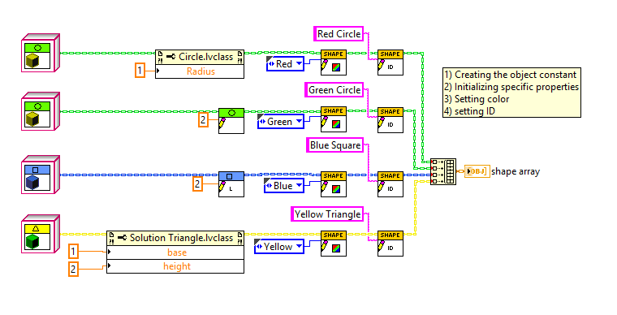
Add new class to the initialization

Slide 47
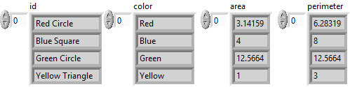
Run top Level VI

Slide 48
Demo Adding Channel
Notes:
I prefer this demo as its closer to what they will have to do also it is a real example.
To prepare for this demo you have to download CEF, you can find it in VI Package manager.
To prepare for this demo create a simple configurator editor

Slide 49
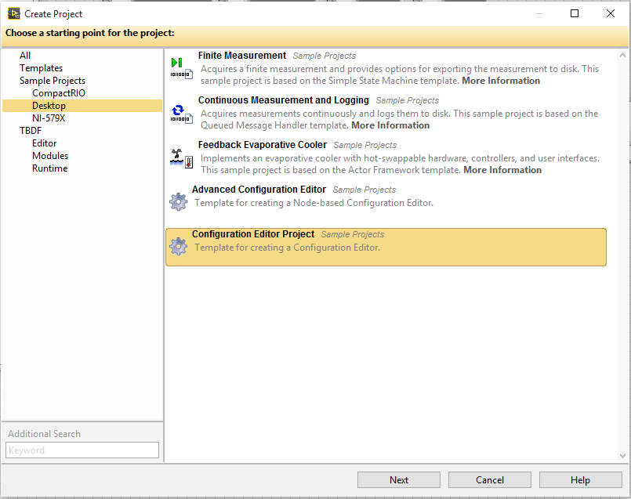
Creating new project from template
Notes:
New Project From Template
I recommend doing this before the presentation and have it already on disk/.

Slide 50
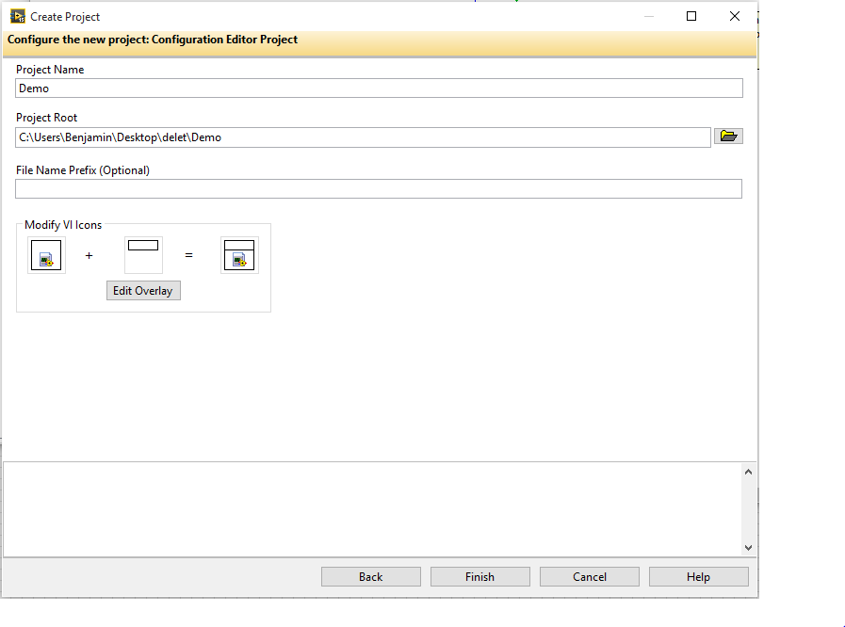
Notes:
After the project is created, run it and give a quick demo so they see the current functionality

Slide 51
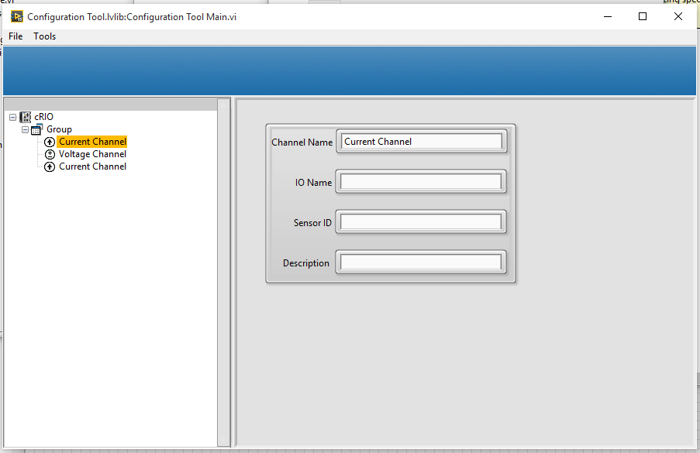
Running the configurator
Notes:
Run the Configuration Tool Main VI
Add some groups and some channels so the audience can see how it is working
Them mentioned we now want to have temperature channels too.
There are many changes we can do including changing the UI, but for this demo we are just changing the Channel name that get initialized and the ICON. Almost every behavior can be change by some override.

Slide 52
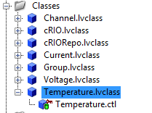
Creating a new Class
To Create a new class Right click on the My computer
New >> Class
This will generate a new class. Save it to disk to a new folder
Notes:
Its really important to use a new folder every time we generate a class.
Name spacing inside LabVIEW is handle by the library but at windows level, there can’t be 2 files with the same name in the same directory.

Slide 53
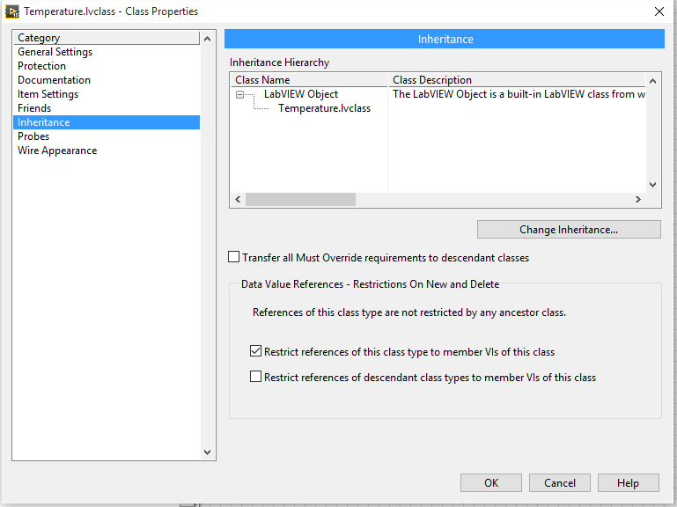
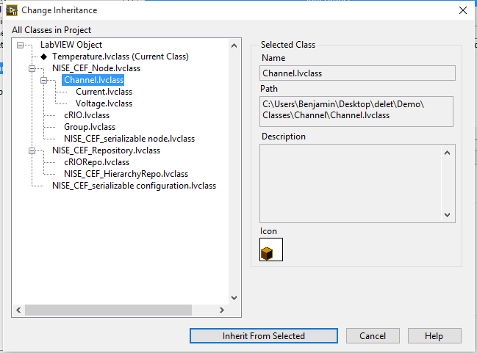
Change Inheritance
Notes:
In properties in the inheritance tab
Select Change Inheritance
Inherit from Channel
In this case we are not changing internal Data just the Icon and the name so we are modifying some properties

Slide 54
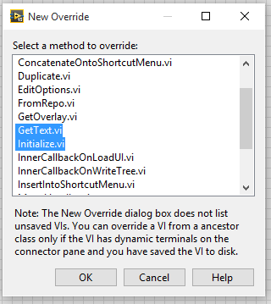
Create Methods for Override
Notes:
There are many Vis we can override for the purpose of this demo we only care about
What methods we need to override depends from the creators of the objects. If they have an * means you have to override.

Slide 55
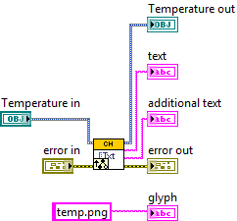
Changing the GetText.VI
Notes:
IN this case we are keeping the parent implementation we are just changing the glyph it will take.

Slide 56
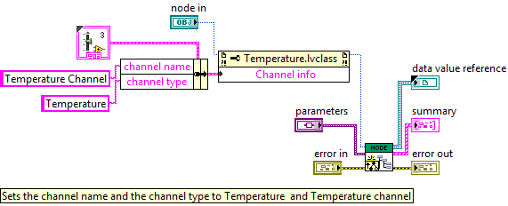
Changing the Initialize VI

Slide 57

Change the group Edit Options VI
Notes:
The framework require the parent node to know which children to ADD.
Just Add Temperature to both arrays.

Slide 58

Running the configurator
Notes:
Run Again and show we now have temperature channels
Explain that we didn't change any on the top level VI, just added a new class.

Slide 59
DCAF Components

Slide 60
DCAF Components
Tag Bus
DCAF Engine
Modules
DCAF Editor
Templates
Examples

Slide 61



Tag Bus
CVT on the wire
Not a Global
Data Protection
Fast
Reduced memory
Filtering
Tag Manipulation
Tags are Objects

Slide 62

DCAF Package Dependency Diagram
Notes:
Useful for navigating Tools Network packages and GitHub Repos
The largest open source LabVIEW development project

Slide 63
DCAF Engine
Engine
Init
Input
Process
Output
Input
Process
Output
Close
Input
Process
Output
Outside
Outside?
Outside

Slide 64

Engine Execution Model
DCAF Execution Engine
Run State
Shutdown
Idle
Tag Bus
Inputs
Process
Outputs
Upkeep
Wait
Configuring
Plugin1
Plugin3
Plugin1
Fault Recovery
Plugin2
Plugin4
Plugin5
House-Keeping
Safe State
Notes:
State machine with a safe state
Sequentially executes Input, Process, and Output methods of each plugin
Passes latest value data between plugins
Configurable execution timing
Built-in error reporting and recovery
Prevent Race conditions, memory allocations, thread starvation, etc.

Slide 65

Simplified Engine

Slide 66

DCAF Execution Engine
Notes:
The source code for the engine isn’t as scary as you might think. It follows a pretty straightforward sequence of steps:
Check for a message to stop.
Wait for next clock source to fire.
Sequentially read all inputs and store data on the bus.
Process data and store on bus, then process again and store on the bus, then process again. Etc.
Send data to all output locations sequentially.
Choose which plugins execute on the next iteration.
Check for errors and handle them.
Sequential execution provides predictable behavior.
C:\Program Files (x86)\National Instruments\LabVIEW 2017\vi.lib\NI\DCAF\Engines\Standard Engine\Execution Engine\main engine\primary control loop.vi

Slide 67

Execute Asynchronously?

Slide 68

Configuration Editor Framework (CEF)
Open Source Library
Tools to manage tree control and subpanels
Can be extended and customized
3 starting templates available

Slide 69
Anatomy of a Module
Editor Node
User interface
Runs on PC
Creates or modifies the configuration
Contains the configuration class
Configuration
Created on PC, passed to runtime system
Provides data access and serialization/unserialization methods
Data storage only, no editor or runtime logic
Runtime Node
Initializes runtime based on configuration
Provides execution logic
Configuration
Editor node
Runtime node

Slide 70
What type of module do I need
Do we really need a custom module??
Use Existing modules
Modify Existing modules
When do you define the inputs and outputs
What is the module doing

Slide 71
Which Template to Choose
Dynamic
Unknown number of Channels.
Final user defines the inputs
Modbus
Needs more codding
Static Template
Number of channels decided by module developer
Mostly Scripted
PID

Slide 72

Tag Bus Module Runtime

Slide 73
When do I define the inputs
Configuration
Unknown number of inputs. Final user defines the inputs
Dynamic Template
Modbus
Development
Always the same number of inputs
Static Template
PID

Slide 74
What is the module doing?
Engine
Input
Process
Output
Outside
Outside
Outside

Slide 75
Static Module
Configuration Class:
Select module options (number of instances, allowable targets)
Update validate.vi with validation rules
Update get default error list.vi with default error classifications
Editor Class:
Select module glyph
Runtime
Implement User Input.vi, User Process.vi, and/or User Output.vi with custom logic

Slide 76

Resources
ni.com/DCAF
Getting started material
Support forum
github.com/LabVIEW-DCAF
Issue reporting
Pull requests welcome!

